Slide 1
Accounting Principles, 7th Edition
Weygandt • Kieso • Kimmel
Chapter 4
Completion of the Accounting Cycle
Prepared by Naomi Karolinski
Monroe Community College
and
Marianne Bradford
Bryant College
John Wiley & Sons, Inc. © 2005

Slide 2
CHAPTER 4 COMPLETION OF THE ACCOUNTING CYCLE
After studying this chapter, you should be able to:
1 prepare a work sheet
2 explain the process of closing the books
3 describe the content and purpose of a post-closing trial balance
4 state the required steps in the accounting cycle
5 explain the approaches to preparing correcting entries
6 identify the sections of a classified balance sheet

Slide 3
WORK SHEET
STUDY OBJECTIVE 1
Work Sheet
  multiple-column form used for the adjustment process and preparing financial statements
  a working tool for the accountant
  not a permanent accounting record
Work Sheet
  makes preparation of adjusting entries and financial statements easier

Slide 4
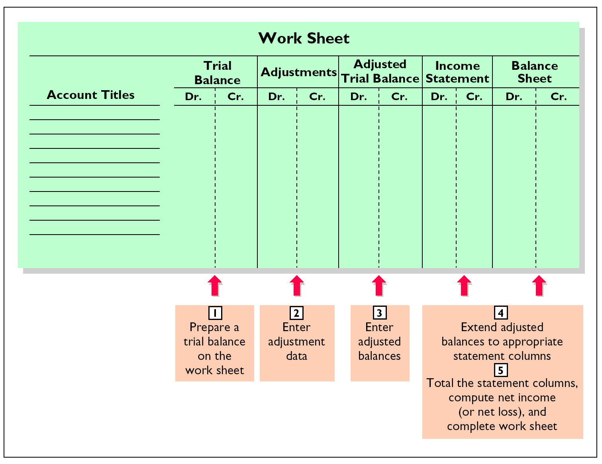
FORM AND PROCEDURE FOR A WORK SHEET

Slide 5
WORK SHEET
Work sheet
  is not a permanent accounting record
When used
  financial statements are prepared from the work sheet
  adjustments are journalized and posted from the work sheet after financial statements

Slide 6
STEPS IN PREPARING A WORK SHEET
1 prepare trial balance
2 enter adjustments in the adjustments columns
3 enter adjusted balances in adjusted trial balance columns
4 extend adjusted trial balance amounts to appropriate financial statement columns
5 total the statement columns, compute net income (loss), and complete the work sheet

Slide 7
PREPARING A WORK SHEET
1 PREPARING A TRIAL BALANCE
PIONEER ADVERTISING AGENCY
Work Sheet
For the Month Ended October 31, 200
5
0015,200 0002,500 0000600 0005,000 5,000 2,500 1,200 000010,000 0000500
10,000
0004,000 0000900 0028,700 28,700
Adjusted
Trial Balance
Adjustments
Trial Balance
Account Titles
Dr.
Cr.
Dr.
Cr.
Dr.
Cr.
Cash
Advertising Supplies
Prepaid Insurance
Office Equipment
quipment
Notes Payable
Accounts Payable
Unearned Revenue
C.R. Byrd, Capital
C.R. Byrd, Drawing
Service Revenue
Salaries Expense
Rent Expense
Totals
.

Slide 8
PREPARING A WORK SHEET
2 ENTER THE ADJUSTMENTS
PIONEER ADVERTISING AGENCY
Work Sheet
For the Month Ended October 31, 2005
Adjusted
Trial Balance
Adjustments
Trial Balance
Account Titles
Dr.
Cr.
Dr.
Cr.
Dr.
Cr.
Cash
15,200
a 1,500 b 50
d 400
d 400
e 200 g 1,200
a 1,500 b 50 c 40 c 40 e 200 f 50 f 50 g 1,200
Advertising Supplies
2,500
Prepaid Insurance
600
Office Equipment
5,000
Notes Payable
5,000
Accounts Payable
2,500
Unearned Revenue
1,200
C.R. Byrd, Capital
10,000
C.R. Byrd, Drawing
500
Service Revenue
10,000
Salaries Expense
4,000
Rent Expense
900
Totals
28,700
28,700
Advertising Supplies Expense
Insurance Expense
Accum. Depr – Off Equip
—
Depreciation Expense
Accounts Receivable
Interest Expense
Interest Payable
Salaries Payable
3,440
3,440
Totals
Notes:
The numbers in this adjustments are off.***********************

Slide 9
PREPARING A WORK SHEET
3 ENTER ADJUSTED BALANCES
PIONEER ADVERTISING AGENCY
Work Sheet
For the Month Ended October 31, 2005
Adjusted
Trial Balance
Adjustments
Trial Balance
Account Titles
Dr.
Cr.
Dr.
Cr.
Dr.
Cr.
Cash
15,200
15,200
1,000
550
5,000
500
5,200
900
1,500
50
40
50
200
5,000
2,500
800
10,000
10,600
40
50
1,200
Advertising Supplies
2,500
a
1,500
Prepaid Insurance
600
b
50
Office Equipment
5,000
Notes Payable
5,000
Accounts Payable
2,500
Unearned Revenue
1,200
d
400
C.R. Byrd, Capital
10,000
C.R. Byrd, Drawing
500
Service Revenue
10,000
d
400
e
200
Sa
laries Expense
4,000
g
1,200
Rent Expense
900
Totals
28,700
28,700
Advertising Supplies Expense
a
1,500
Insurance Expense
b
50
Accum. Depr – Off Equip
c
40
—
Depre
ciation Expense
c
40
Interest Expense
f
50
Accounts Receivable
e
200
Interest Payable
f
50
Salaries Payable
g
1,200
Totals
3,440
3,440
30,190
30,190

Slide 10
PREPARING A WORK SHEET
4 EXTEND ADJUSTED BALANCES
PIONEER ADVERTISING AGENCY
Work Sheet
For the Month Ended October 31, 200
5
Adjusted
Income
Trial Balance
Statement
Balance Sheet
Account Titles
Dr.
Cr.
Dr.
Cr.
Dr.
Cr.
Cash
15,200
Advertising Supplies
1,000
Prepaid Insurance
5
50
10,600.0 5,200.0 0000000 900.00000000 1,500.000000000 50.0000000
40 5 50
Office Equipment
5,000
Notes Payable
5,000
Accounts Payable
2,500
Unearned Revenue
800
C.R. Byrd, Capital
10,000
C.R. Byrd, Drawing
500
Service Revenue
10,600
Salaries Expense
5,200
Rent Expense
90
0
Advertising Supplies Expense
1,500
Insurance Expense
50
Accum. Depr.
—
Office Equip.
40
Depreciation Expense
40
Interest Expense
50
Accounts Receivable
200
Interest Payable
50
Salaries Payable
1,20
0
Totals
30,190
30,190
7,740
10,600
Net Income
2,860
Totals
10,600
10,600

Slide 11
PREPARING A WORK SHEET
4 EXTEND ADJUSTED BALANCES
PIONEER ADVERTISING AGENCY
Work Sheet
For the Month Ended October 31, 2005
Adjusted
Income
Trial Balance
Statement
Balance Sheet
Account Titles
Dr.
Cr.
Dr.
Cr.
Dr.
Cr.
Cash
15,200
5,200 1,000 5 550 5,000 5,000 2,500 800 10,000 5500
40
200 50 1,200
Advertising Supplies
1,000
Prepaid Insurance
5
50
Office Equipment
5,000
Notes Payable
5,000
Accounts Payable
2,500
Unearned Revenue
800
C.R. Byrd, Capital
10,000
C.R. Byrd, Drawing
500
Service Revenue
10,600
10,600
Salaries Expense
5,200
5,200
Rent
Expense
900
900
Advertising Supplies Expense
1,500
1,500
Insurance Expense
50
50
Accum. Depr.
—
Office Equip.
40
Depreciation Expense
40
40
Interest Expense
50
50
Accounts Receivable
200
Interest Payable
50
Salaries Payable
1,200
Totals
30,190
30,190
7,740
10,600
22,450
19,590
Net Income
2,860
2,860
Totals
10,600
10,600
22,450
22,450

Slide 12
ADJUSTING ENTRIES JOURNALIZED
GENERAL JOURNAL
Date
Account Titles and Explanation
Ref.
Debit
Credit
200
5
a
Advertising Supplies Expense 1,500
Advertising Supplies 1,500
Insurance Expense 50
Prepaid Insurance 50
Depreciation Expense 40
Accumulated Expense 40
Unearned Fees 400
Fees Earned 400
Accounts Receivable 200
Fees Earned 200
Interest Expense 50
Interest Payable 50
Salaries Expense 1,200
Salaries Payable 1,200
Oct. 31
b
31
c
31
d
31
e
31
f
31
g
31

Slide 13
PREPARATION OF FINANCIAL STATEMENTS INCOME STATEMENT
PIONEER ADVERTISING AGENCY
Income Statement
For the Month Ended October 31, 2005
Revenues
$10,600
$5,200
1,500
900
50
50
40
Service revenue
Expenses
Salaries expense
Advertising supplies expense
The income statement is prepared from the income statement columns of the work sheet.
Rent expense
Insurance expense
Interest expense
Depreciation expense
Total expenses
7,740
$ 2,860
Net income

Slide 14
PREPARATION OF FINANCIAL STATEMENTS OWNER’S EQUITY STATEMENT
PIONEER ADVERTISING AGENCY
Owner’s Equity Statement
For the Month Ended October 31, 2005
C.R. Byrd, Capital, October 1
$ -0-
$10,000
2,860 12,860
12,860
500
$12,360
Add: Investments
The owner’s equity statement is prepared from the balance sheet columns of the work sheet.
Net income
Less: Drawings
C.R. Byrd, Capital, October 31

Slide 15
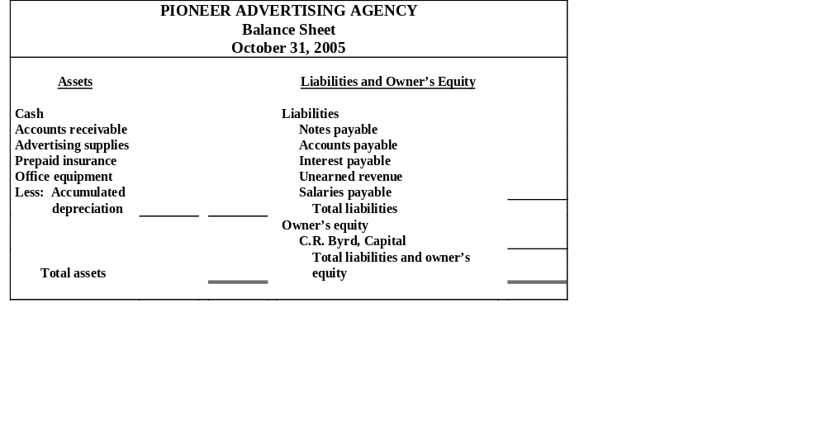
PREPARATION OF FINANCIAL STATEMENTS BALANCE SHEET
$ 15,200
200
1,000
550
$5,000
40 4,960
$21,910
$ 5,000
2,500
50
800
1,200
9,550
12,360
$21,910
The balance sheet is prepared from the balance sheet columns of the work sheet.

Slide 16
A work sheet can be thought of as a(n)
  permanent accounting record
  optional device used by accountants
  part of the general ledger
  part of the journal

Slide 17
A work sheet can be thought of as a(n)
  permanent accounting record
  optional device used by accountants
  part of the general ledger
  part of the journal

Slide 18
TEMPORARY VERSUS PERMANENT ACCOUNTS
STUDY OBJECTIVE 2
TEMPORARY (NOMINAL) PERMANENT (REAL) These accounts are closed These accounts are not closed
All revenue accounts All asset accounts
All expense accounts All liability accounts
Owner’s drawing Owner’s capital account

Slide 19
CLOSING ENTRIES
Closing entries
  Formally transfers net income (loss) and owner’s drawings to owner’s capital
  Journalizing and posting is a required step in the accounting cycle
Income Summary
  A temporary account
  Used in closing revenue and expense accounts
  Minimizes the details in the permanent owner’s capital account

Slide 20
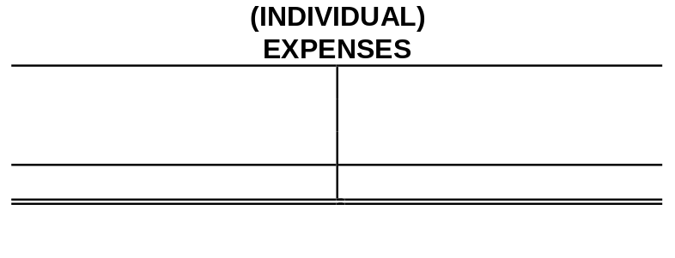
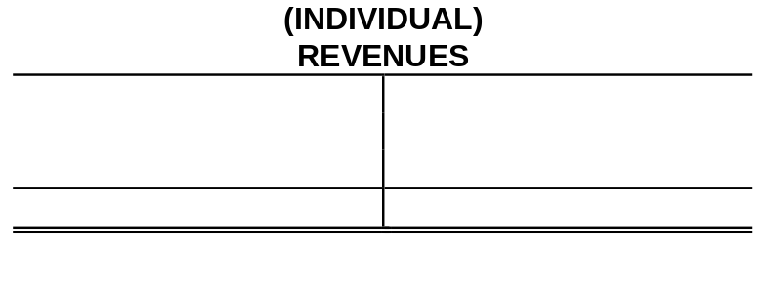

DIAGRAM OF CLOSING PROCESS
PROPRIETORSHIP
2
1
1 Debit each revenue account for its balance, and credit Income Summary for total revenues.
2 Debit Income Summary for total expenses, and credit each expense account for its balance.

Slide 21


DIAGRAM OF CLOSING PROCESS
3
3 Debit (credit) Income Summary and credit (debit) owner’s capital for the amount of net income (loss).

Slide 22

DIAGRAM OF CLOSING PROCESS
4
4 Debit owner’s capital for the balance in the owner’s drawing account and credit owner’s drawing for the same amount.

Slide 23

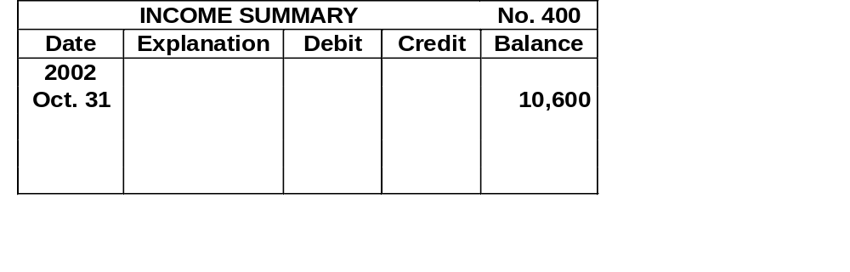

CLOSING ENTRIES JOURNALIZED
10,600
10,600

Slide 24
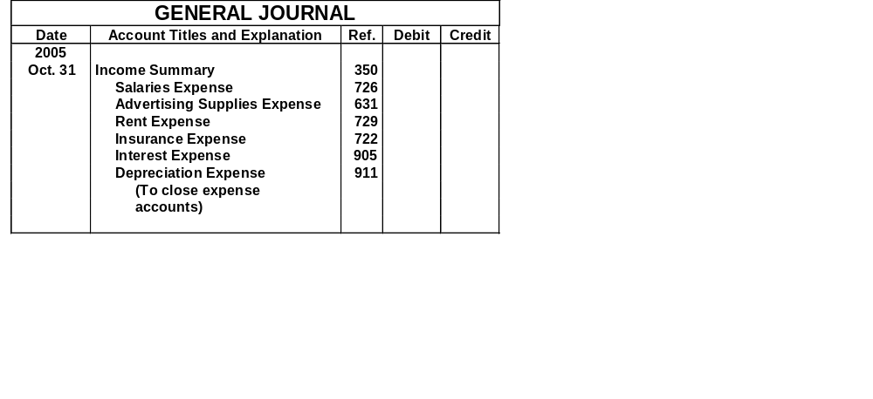
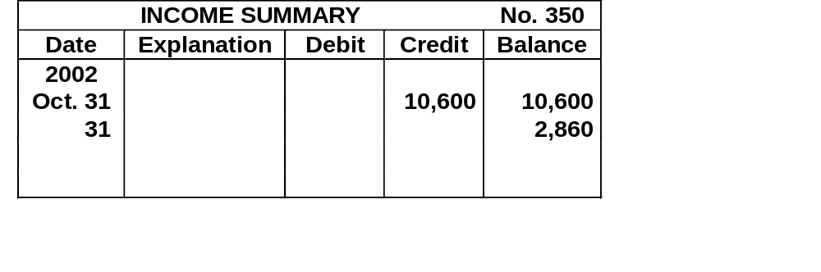
CLOSING ENTRIES JOURNALIZED
7,740
5,200
1,500
900
50
50
40
7,740
Notes:
Can’t fix the 2002 here-Help?

Slide 25

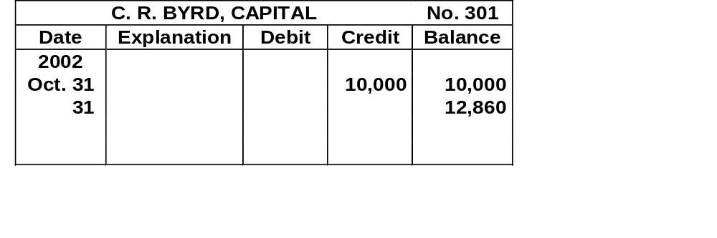
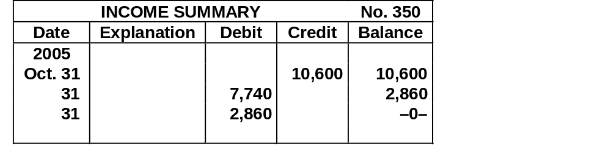
CLOSING ENTRIES JOURNALIZED
2,860
Notes:
Can’t Fix 301 to the year 2005.

Slide 26
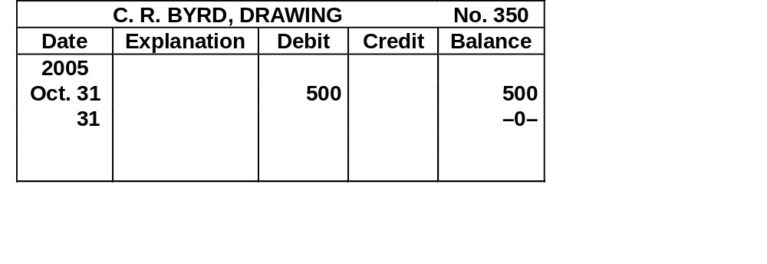
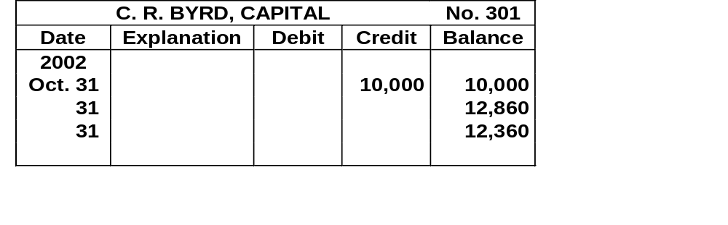
CLOSING ENTRIES JOURNALIZED
GENERAL JOURNAL
Date
Account Titles and Explanation
Ref.
Debit
Credit
2005
(4)
Oct. 31
C. R. Byrd, Capital
350
500
500
C. R. Byrd, Drawing
301
(To close net income to
capital)
500
500
Notes:
I am unable to Fix Account 301 to get to the year 2005. To much grouping and imported objects.

Slide 27
CAUTIONS RELATING TO CLOSING ENTRIES
Caution:
Avoid doubling revenue and expense balances
Owner’s Drawing does not move to the Income Summary account. Owner’s drawing is not an expense and it is not a factor in determining net income.

Slide 28
POSTING CLOSING ENTRIES
Temporary accounts
  All temporary accounts will have zero balances after posting the closing entries
  Temporary accounts (revenues and expenses) are totaled, balanced and double ruled
Owner’s capital
  Total equity of the owner at the end of the accounting period
  No entries are journalized and posted to owner’s capital during the year
Permanent accounts (assets, liabilities, and owner’s capital) not closed

Slide 29
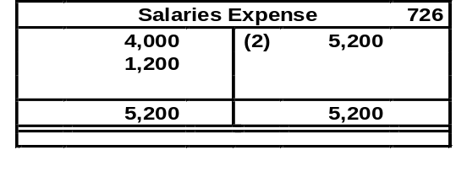
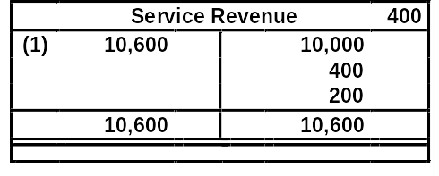
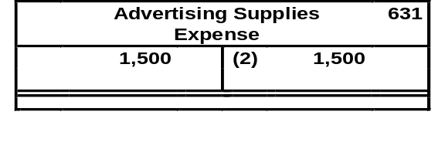
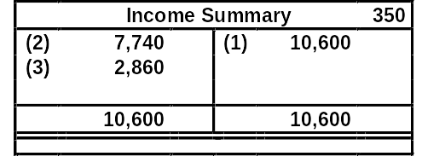
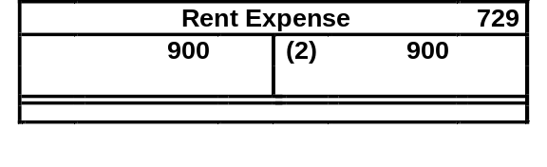
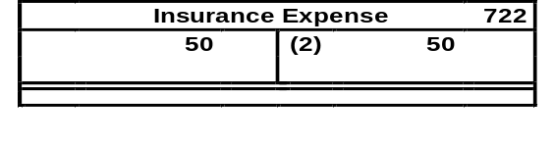
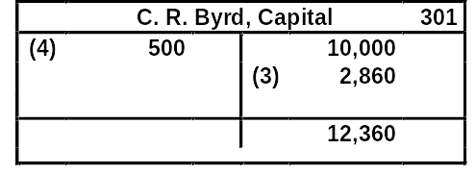
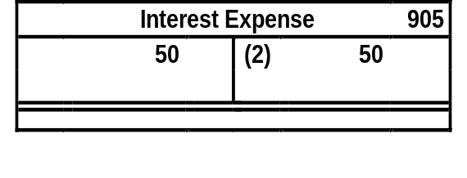
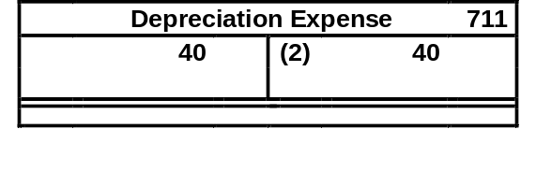
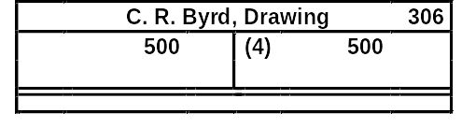
POSTING OF CLOSING ENTRIES
2
1
3
2
4

Slide 30
POST-CLOSING TRIAL BALANCE
STUDY OBJECTIVE 3
  After all closing entries have been journalized the post-closing trial balance is prepared from the ledger.
The purpose of this trial balance is to
  prove the equality of the permanent account balances that are carried forward into the next accounting period.

Slide 31
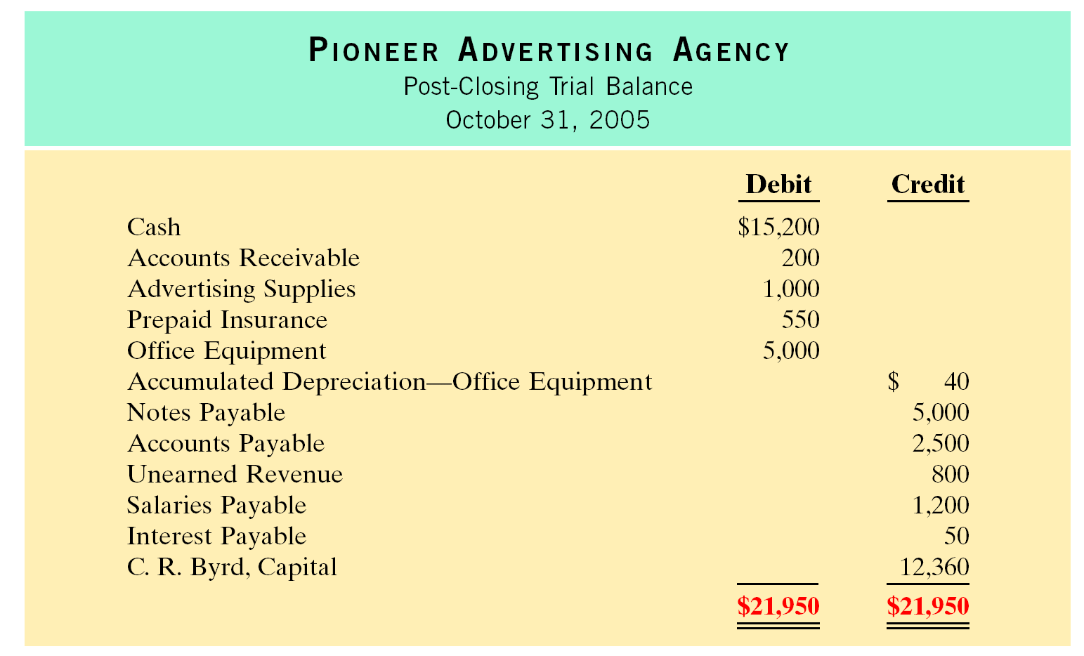
POST-CLOSING TRIAL BALANCE

Slide 32
STEPS IN THE ACCOUNTING CYCLE
STUDY OBJECTIVE 4
1 Analyze business transactions
2 Journalize the transactions
3 Post to ledger accounts
4 Prepare a trial balance
5 Journalize and post adjusting entries

Slide 33
STEPS IN THE ACCOUNTING CYCLE
6 Prepare an adjusted trial balance
7 Prepare financial statements: Income Statement, Owner’s Equity Statement, Balance Sheet
8 Journalize and post closing entries
9 Prepare a post-closing trial balance

Slide 34
REVERSING ENTRIES
Reversing entry
  Made at the beginning of the next accounting period
  Purpose is to simplify the recording of a subsequent transaction related to an adjusting entry
  Most often used to reverse two types of adjusting entries: accrued revenues and accrued expenses
Notes:
Cant Get Bullets to appear one at a time.

Slide 35
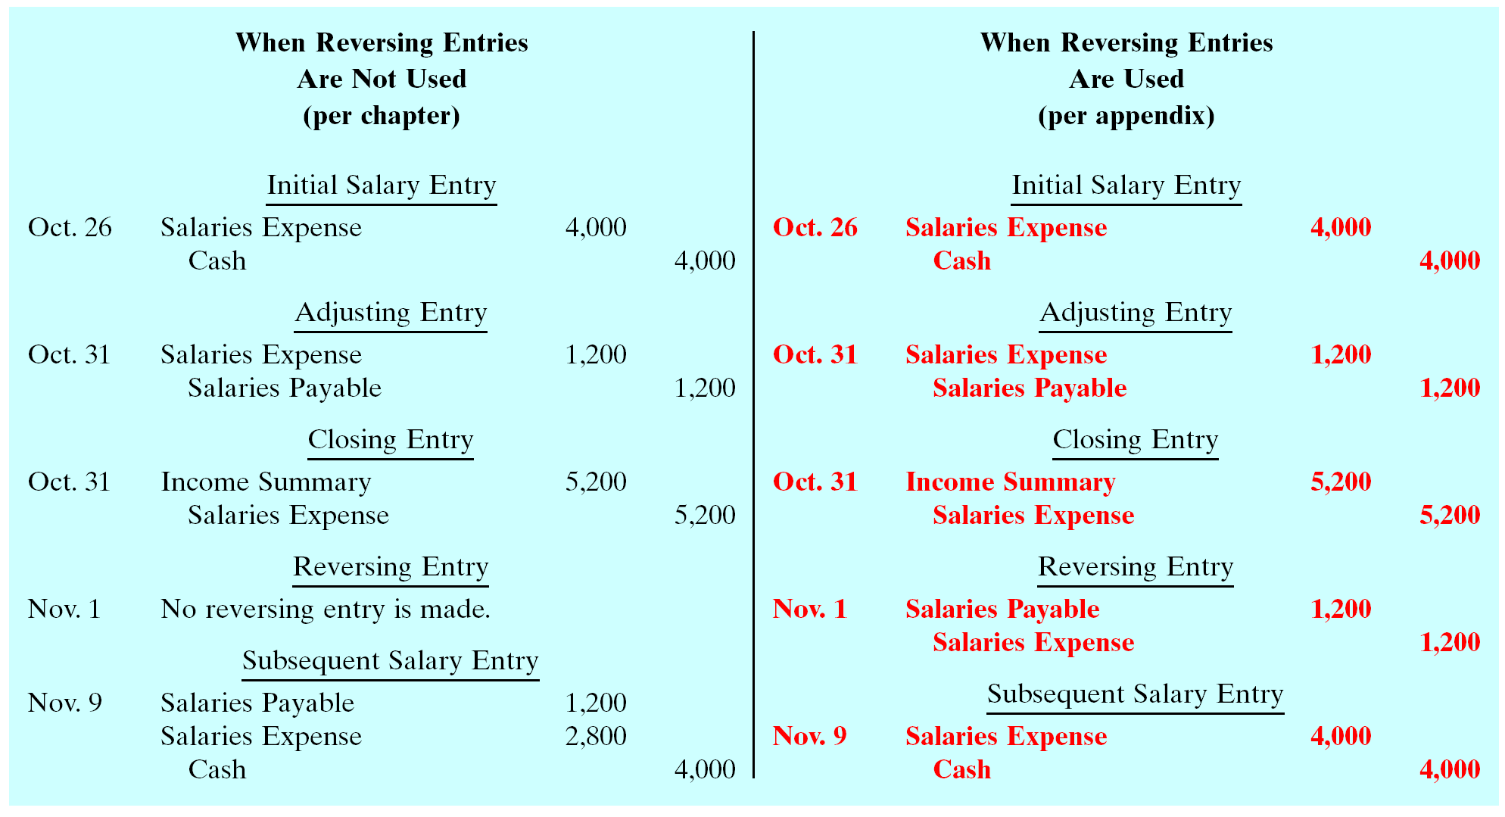
ILLUSTRATIVE EXAMPLE OF REVERSING ENTRY
Notes:
In my editing I really messed this up. Someone with more knowledge needs to fix this.

Slide 36
CORRECTING ENTRIES
STUDY OBJECTIVE 5
Correcting Entries
  errors should be corrected as soon as discovered
  correcting entries are unnecessary if records are free of errors
  can be journalized and posted whenever an error is discovered
  involve any combination of balance sheet and income statement accounts

Slide 37
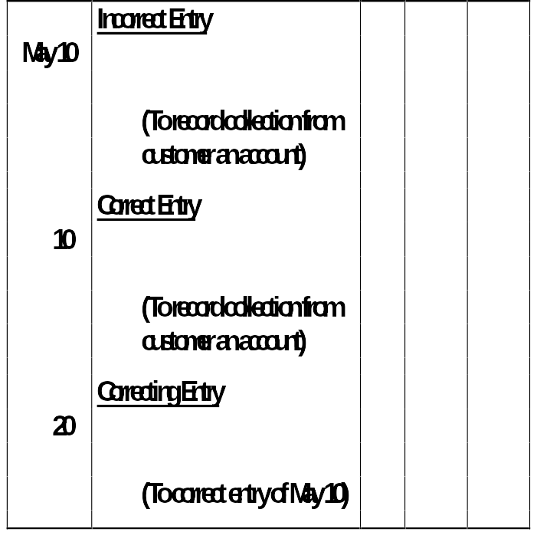
ILLUSTRATIVE EXAMPLE OF CORRECTING ENTRY 1
Cash 50
Service Revenue 50
Cash 50
Accounts Receivable 50
Service Revenue 50
Accounts Receivable 50

Slide 38
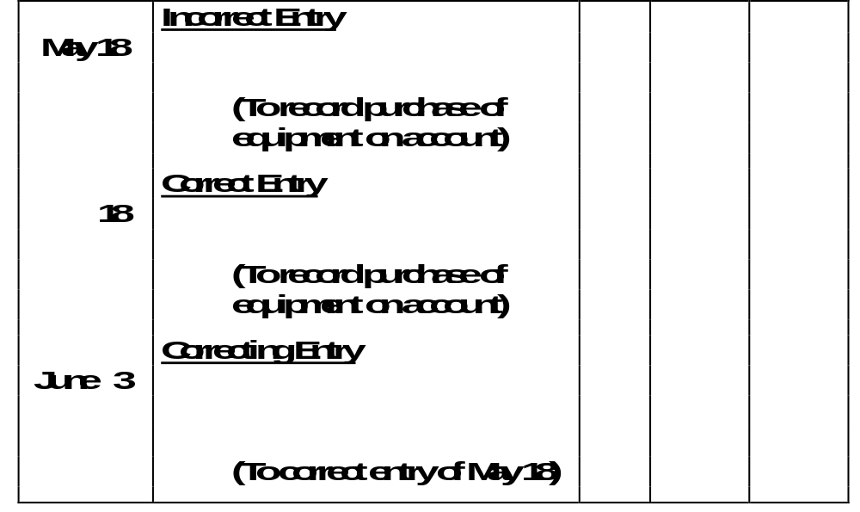
ILLUSTRATIVE EXAMPLE OF
CORRECTING ENTRY 2
Delivery Equipment 45
Accounts Payable 45
Office Equipment 450
Accounts Payable 450
Office Equipment 450
Delivery Equipment 45
Accounts Payable 405

Slide 39
The closing entry process consists of closing
  all asset and liability accounts
  out the owner's capital account
  all permanent accounts
  all temporary accounts

Slide 40
The closing entry process consists of closing
  all asset and liability accounts
  out the owner's capital account
  all permanent accounts
  all temporary accounts

Slide 41
STANDARD BALANCE SHEET CLASSIFICATIONS
STUDY OBJECTIVE 6
Financial statements become more useful when the elements are classified into significant subgroups.
A classified balance sheet generally has the following standard classifications:
Current Assets Current Liabilities
Long-Term Investments Long-Term Liabilities
Property, Plant and Owner’s (Stockholders’) Equity Equipment
Intangible Assets
Assets Liabilities and Owner’s Equity

Slide 42

CURRENT ASSETS
Current assets
  Cash and other resources that are reasonably expected to be realized in cash or sold or consumed in the business within one year of the balance sheet date or the company’s operating cycle, whichever is longer
  Current assets are listed in the order of their liquidity
Operating cycle of a company
  This is the average time required to go from cash to cash in producing revenues
Examples
  Inventory, accounts receivable and cash

Slide 43
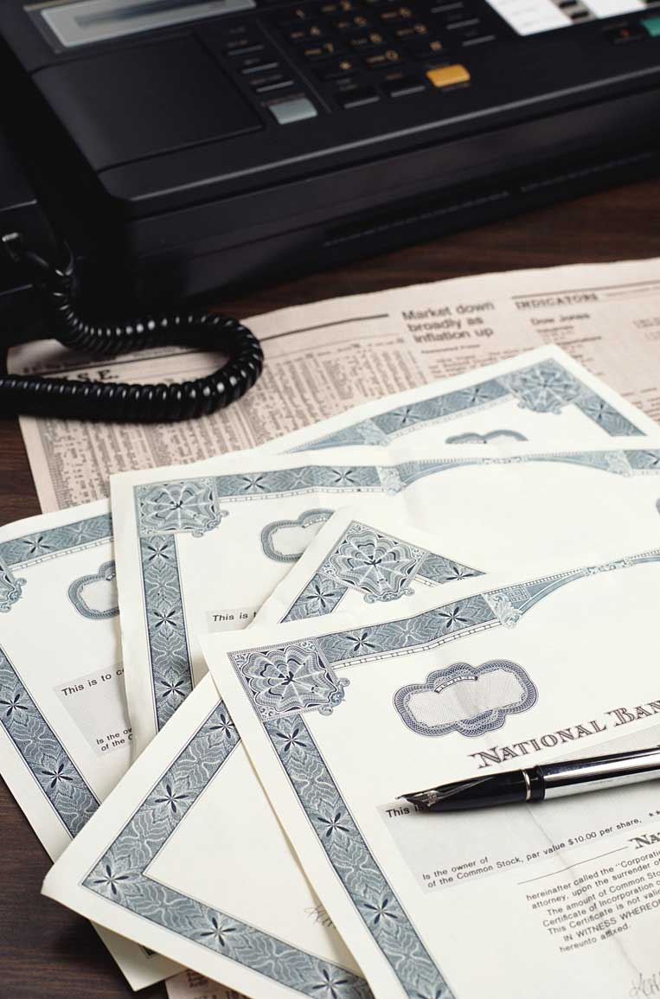
LONG-TERM INVESTMENTS
Long-term investments
  Resources which can be realized in cash
  Their conversion into cash is not expected within one year or the operating cycle, whichever is longer
Examples
  Investments in bonds of another company or investment in land held for resale
XYZ stock

Slide 44
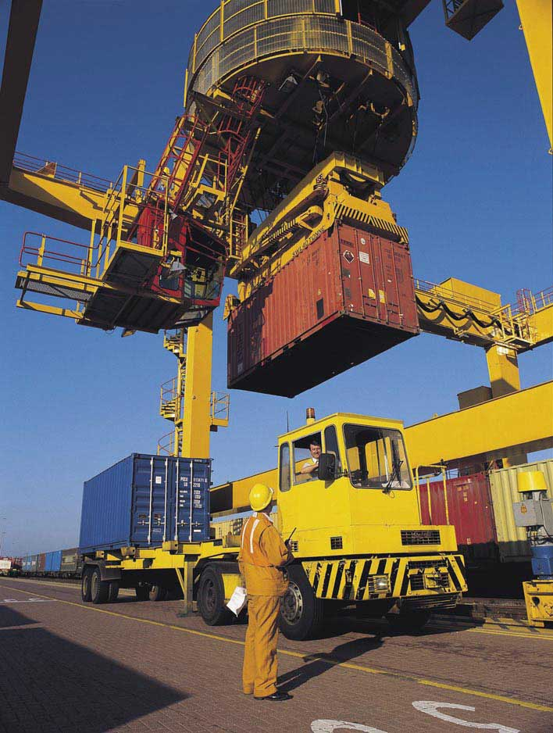
PROPERTY, PLANT, AND EQUIPMENT
Property, plant, and equipment
  Tangible resources, relatively permanent nature, used in the business, and not intended for sale
Examples
  Land, buildings, and machinery

Slide 45

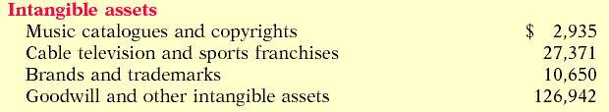
INTANGIBLE ASSETS
Intangible assets
  Non-current resources that do not have physical substance
Examples
  Includes patents, copyrights, trademarks, or trade names, gives the holder exclusive right of use for a specified period of time

Slide 46
CURRENT LIABILITIES
Current liabilities
  Obligations reasonably expected to be paid from existing current assets or through the creation of other current liabilities within one year or the operating cycle, whichever is longer
Examples
  Accounts payable, wages payable, interest payable and current maturities of long-term debt

Slide 47
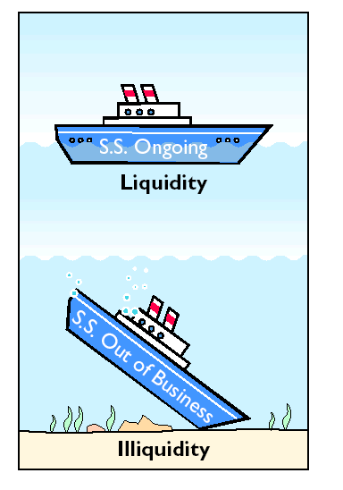
CURRENT LIABILITIES
Liquidity is the ability of a company to pay obligations that are expected to become due within the next year or operating cycle.

Slide 48
LONG-TERM LIABILITIES
Long-term liabilities Obligations expected to be paid after one year
Examples
  Long-term notes payable, bonds payable, mortgages payable, and lease liabilities

Slide 49
OWNER’S EQUITY
The content of the owner’s equity section
  Varies with the form of business organization
Proprietorship
  A single owner’s equity account called (Owner’s Name), Capital
Partnership
  Separate capital accounts for each partner
Corporation
  Called stockholders’ equity, and it consists of two accounts: Capital Stock and Retained Earnings

Slide 50
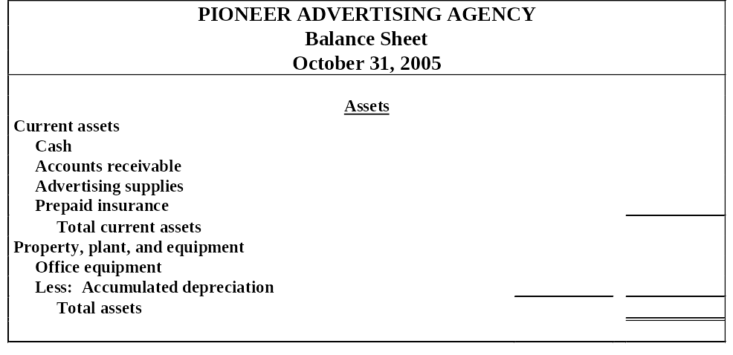
CLASSIFIED BALANCE SHEET IN ACCOUNT FORM
$ 15,200
200
1,000
550
16,950
$5,000
40 4,960
$21,910
A classified balance sheet
1 availability of assets to meet debts
2 claims of short- and long-term creditors on total assets

Slide 51
CLASSIFIED BALANCE SHEET IN REPORT FORM
Liabilities and Owner’s Equity
$ 1,000
2,500
50
800
1,200
5,550
4,000
9,550
12,360
$21,910
Current liabilities
Notes payable
Accounts payable
Interest payable
Unearned revenue
Salaries payable
Total current liabilities
Long-term liabilities
Notes payable
Total liabilities
Owner’s equity
C. R. Byrd, Capital
Total liabilities and owner’s equity
The balance sheet is most often presented in the report form, with the assets above liabilities and owner’s equity.

Slide 52
A current asset is
  the last asset purchased by a business
  an asset which is currently being used to produce a product or service
  usually found as a separate classification in the income statement
  expected to be realized in cash, sold or consumed within one year of the balance sheet or the company's operating cycle, whichever is longer

Slide 53
A current asset is
  the last asset purchased by a business
  an asset which is currently being used to produce a product or service
  usually found as a separate classification in the income statement
  expected to be realized in cash, sold or consumed within one year of the balance sheet or the company's operating cycle, whichever is longer

Slide 54

COPYRIGHT
Copyright © 2005 John Wiley & Sons, Inc. All rights reserved. Reproduction or translation of this work beyond that permitted in Section 117 of the 1976 United States Copyright Act without the express written consent of the copyright owner is unlawful. Request for further information should be addressed to the Permissions Department, John Wiley & Sons, Inc. The purchaser may make back-up copies for his/her own use only and not for distribution or resale. The Publisher assumes no responsibility for errors, omissions, or damages, caused by the use of these programs or from the use of the information contained herein.

